Slide 1
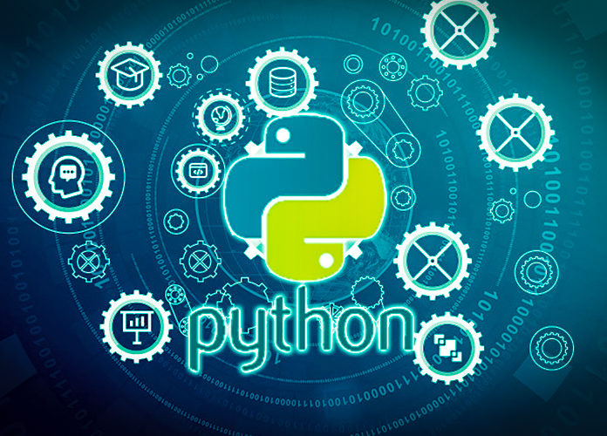
Data Programming in Python _________________ Collection Data Types

Slide 2
Lists
Lists are ordered [0, 1, 2, 3, 4]
Lists are mutable (can be changed) with dot methods
list1.append()
list1.remove()
lotto = [2, 14, 6, 41, 63]
lotto[2] = 30
print(lotto)
>>> [2, 14, 30, 41, 63]
lotto.append(1)
print(lotto)
>>> [2, 14, 30, 41, 63, 1]

Slide 3
Dictionaries
Dictionaries use curly braces and have a collection of key : value pairs
Think of it as looking up a value (definition) in a dictionary based on the key (word)
scores = { 'Chuck' : 61 , 'Fred' : 42, 'Jan': 100}
print(scores['Fred’])> 42

Slide 4
Tuples
Tuples are very similar to lists: less flexible and not mutable, but optimized for speed and efficiency
Tuples use parentheses to denote them.
Tuples elements can vary in data type.
coordinates = (-1, 3, 7)
matchup = (‘Nebraska’, 'Iowa')

Slide 5
Sets
Sets are defined using the set function or curly braces (like dictionaries but without colon)
No order to them and only unique values
days = {'Monday', 'Tuesday', 'Wednesday'}
letters = ['A', 'C', 'A', 'A', 'B', 'B', 'C']
options = set(letters) > {'A', 'C', 'B'}

Slide 6
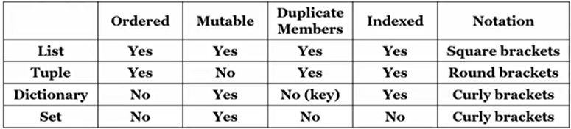
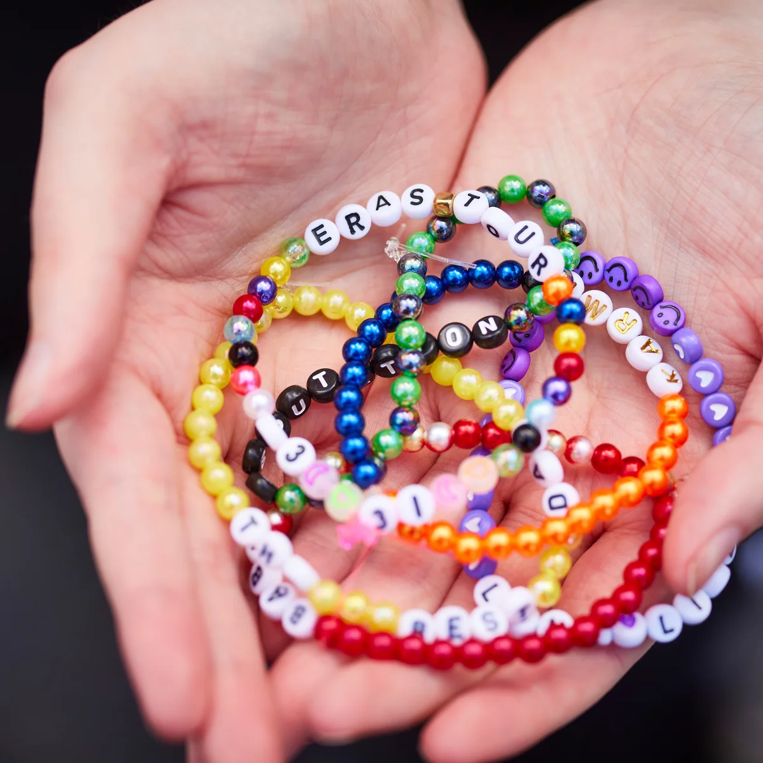
Storing data together
Different characteristics:
List, tuple, dictionary, set

